Slide 1
Shortest Paths
0
8
A
4
2
8
7
2
1
3
B
C
D
5
3
9
8
2
E
F
5

Slide 2
Weighted Graphs
In a weighted graph, each edge has an associated numerical value, called the weight of the edge
Edge weights may represent, distances, costs, etc.
Example:
In a flight route graph, the weight of an edge represents the distance in miles between the endpoint airports
849
PVD
1843
ORD
142
SFO
802
LGA
1743
1205
337
1387
HNL
2555
1099
LAX
1233
DFW
1120
MIA

Slide 3
Shortest Paths
Given a weighted graph and two vertices u and v, we want to find a path of minimum total weight between u and v.
Length of a path is the sum of the weights of its edges.
Example:
Shortest path between Providence and Honolulu
Applications
Internet packet routing
Flight reservations
Driving directions
849
PVD
1843
ORD
142
SFO
802
LGA
1743
1205
337
1387
HNL
2555
1099
LAX
1233
DFW
1120
MIA

Slide 4
Shortest Path Properties
Property 1:
A subpath of a shortest path is itself a shortest path
Property 2:
There is a tree of shortest paths from a start vertex to all the other vertices
Example:
Tree of shortest paths from Providence (PVD)
849
PVD
1843
ORD
142
SFO
802
LGA
1743
1205
337
1387
HNL
2555
1099
LAX
1233
DFW
1120
MIA

Slide 5
Our goal and Initial Ideas
Goal
Given a source vertex s, I want to compute the shortest paths to all other vertices
Initial Ideas
Compute all the paths from the source s to other vertices
Take the minimums
How much complexity?
Exponential (not a polynomial time algorithm)
Why is this algorithm stupid?
Ignore the wisdom from computing the minimum path for computing other minimum paths

Slide 6
Dijkstra’s Algorithm (1)
The distance of a vertex v from a vertex s is the length of a shortest path between s and v
Dijkstra’s algorithm computes the distances of all the vertices from a given start vertex s
Assumptions:
the graph is connected
the edges are undirected
the edge weights are nonnegative
We grow a “cloud” of vertices, beginning with s and eventually covering all the vertices
Remember the “wisdom”
Example
What is your distance to ”Obama” in facebook? 50
Suppose that MoonJaein becomes your friend
What is your distance to “Obama” then?
Probably much shorter than 50. Maybe 2? ☺

Slide 7
Example first
0
0
8
A
4
8
A
4
2
2
8
7
2
1
4
8
7
2
1
3
B
C
D
B
C
D
∞
3
9
∞
5
3
9
8
2
E
F
5
2
E
F
5
0
0
8
A
4
8
A
4
2
2
8
7
2
1
3
7
7
2
1
3
B
C
D
B
C
D
5
3
9
11
5
3
9
8
2
E
F
5
2
E
F
5

Slide 8
Example (cont.)
0
8
A
4
2
7
7
2
1
3
B
C
D
5
3
9
8
2
E
F
5
0
8
A
4
2
7
7
2
1
3
B
C
D
5
3
9
8
2
E
F
5

Slide 9
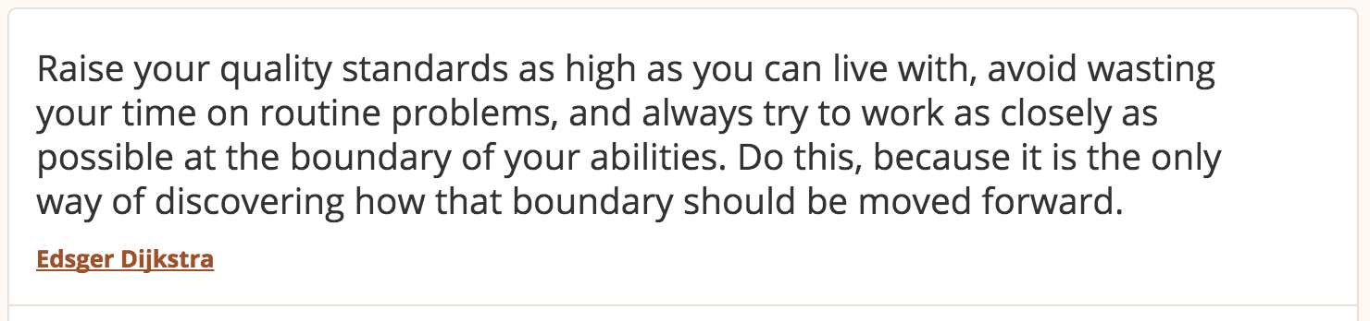
Dijkstra’s Algorithm (2)
We store with each vertex v a label d(v) representing the distance of v from s in the subgraph consisting of the cloud and its adjacent vertices
At each step
We add to the cloud the vertex u outside the cloud with the smallest distance label, d(u)
We update the labels of the vertices adjacent to u
Greedy method: we solve the problem at hand by repeatedly selecting the best choice from among those available in each iteration

Slide 10
Edge Relaxation
Consider an edge e = (u,z) such that
u is the vertex most recently added to the cloud
z is not in the cloud
The relaxation of edge e updates distance d(z) as follows:
d(z) ← min{d(z),d(u) + weight(e)}
Distance to z, not considering u
d(u) = 50
10
d(z) = 75
u
e
s
z
Distance to z,
considering u
d(u) = 50
10
d(z) = 60
u
e
s
z

Slide 11
Recall: Priority Queue ADT
A priority queue stores a collection of entries
Typically, an entry is a pair (key, value), where the key indicates the priority
Main methods of the Priority Queue ADT
insert(e) inserts an entry e
removeMin() removes the entry with smallest key
Additional methods
min() returns, but does not remove, an entry with smallest key
size(), empty()
Applications:
Standby flyers
Auctions
Stock market

Slide 12
Dijkstra’s Algorithm
A heap-based adaptable priority queue with location-aware entries stores the vertices outside the cloud
Key: distance
Value: vertex
Recall that method replaceKey(l,k) changes the key of entry l with k
We store two labels with each vertex:
Distance
Entry in priority queue
We take out the vertex with the minimum distance so far
Algorithm DijkstraDistances(G, s)
Q ← new heap-based priority queue
for all v ∈ G.vertices()
if v = s
v.setDistance(0)
else
v.setDistance(∞)
l ← Q.insert(v.getDistance(), v)
v.setEntry(l)
while ¬Q.empty()
l ← Q.removeMin()
u ← l.getValue() // take out the closest node
for all e ∈ u.incidentEdges() { relax e }
z ← e.opposite(u)
r ← u.getDistance() + e.weight()
if r < z.getDistance()
z.setDistance(r) Q.replaceKey(z.getEntry(), r)

Slide 13
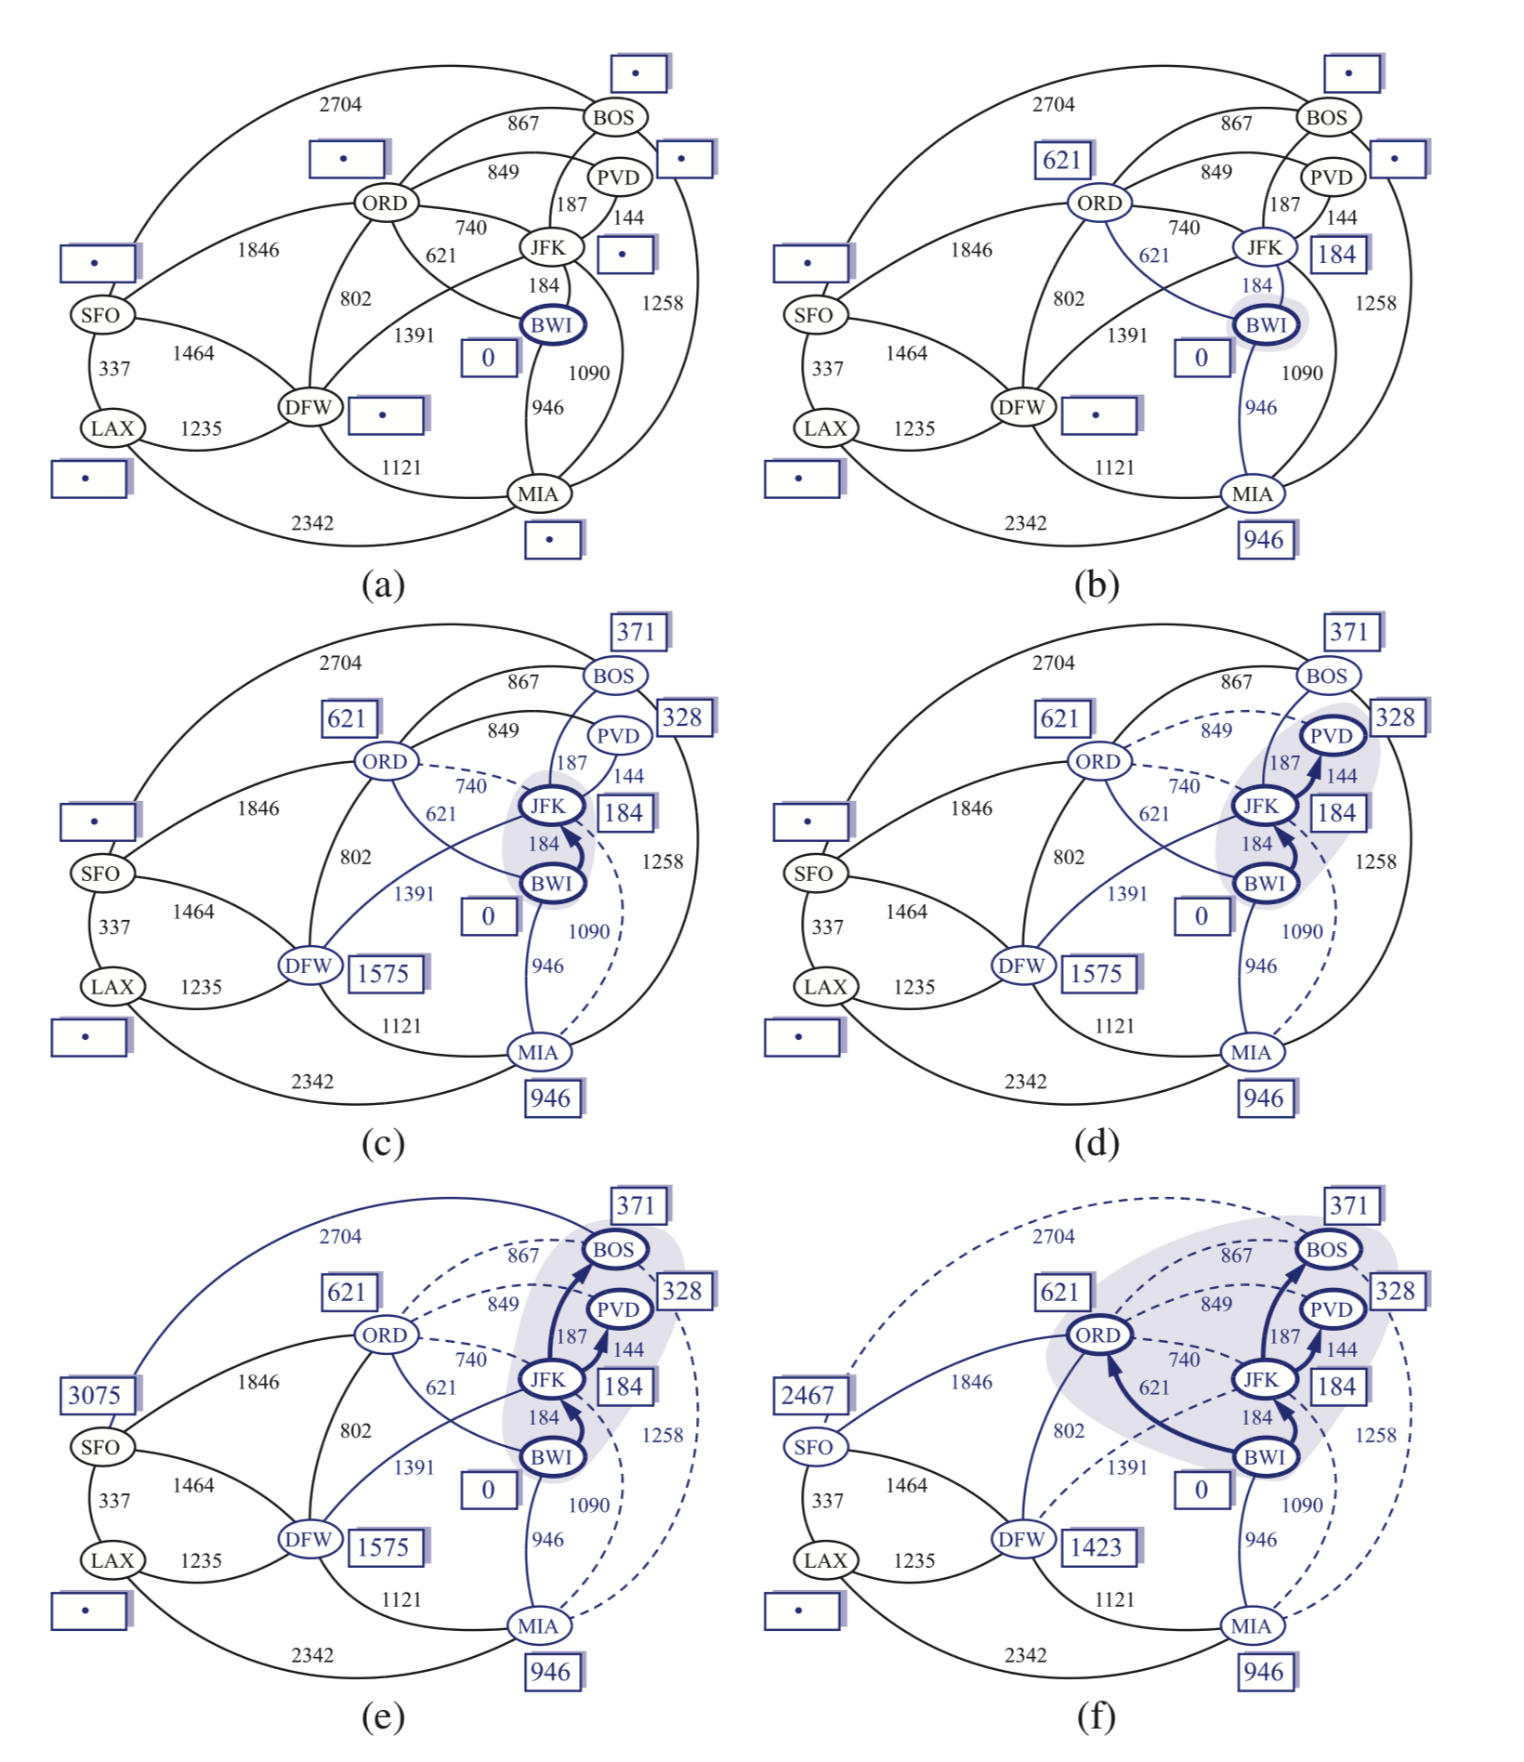

Slide 14
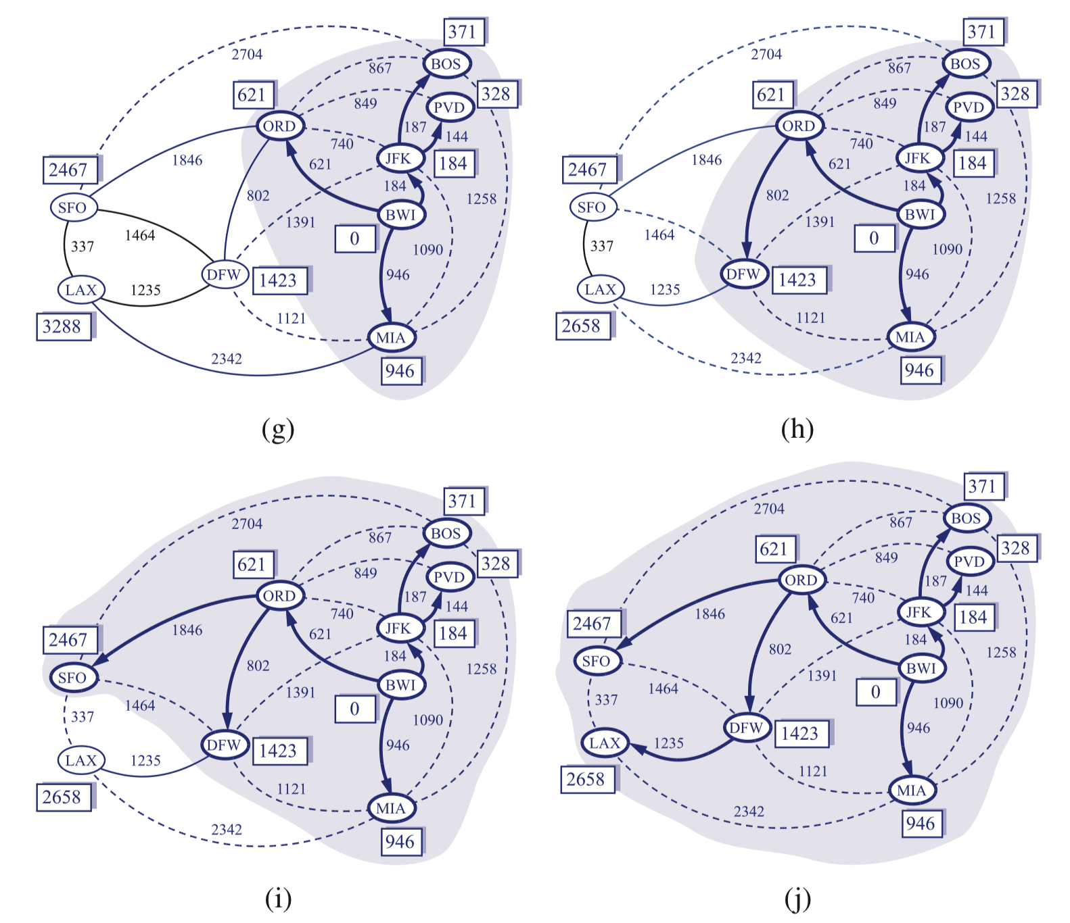

Slide 15
Why Dijkstra’s Algorithm Works
Dijkstra’s algorithm is based on the greedy method. It adds vertices by increasing distance.
Suppose it didn’t find all shortest distances. Let F be the first wrong vertex the algorithm processed.
When the previous node, D, on the true shortest path was considered, its distance was correct
But the edge (D,F) was relaxed at that time!
Thus, so long as d(F)>d(D), F’s distance cannot be wrong. That is, there is no wrong vertex
(Question) Why not working for non-negative weight?
0
8
A
4
2
7
7
2
1
3
B
C
D
5
3
9
8
2
E
F
5

Slide 16
Analysis of Dijkstra’s Algorithm
Graph operations
incidentEdges is called once for each v
Label operations
We set/get the distance and locator labels of vertex z, O(deg(z)) times
Setting/getting a label takes O(1) time
Priority queue operations
Each v is inserted once into and removed once from the PQ, where each insertion or removal takes O(log n) time → total nO(log n)
The key of a vertex in the PQ is modified at most deg(v) times, where each key change takes O(log n) time
Dijkstra’s algorithm runs in O((n + m) log n) time provided the graph is represented by the adjacency list structure
Recall that Σ_{v} deg(v) = 2m
The running time can also be expressed as O(m log n) since the graph is connected
Algorithm DijkstraDistances(G, s)
Q ← new heap-based priority queue
for all v ∈ G.vertices()
if v = s
v.setDistance(0)
else
v.setDistance(∞)
l ← Q.insert(v.getDistance(), v)
v.setEntry(l)
while ¬Q.empty()
l ← Q.removeMin()
u ← l.getValue() // take out the closest node
for all e ∈ u.incidentEdges() { relax e }
z ← e.opposite(u)
r ← u.getDistance() + e.weight()
if r < z.getDistance()
z.setDistance(r) Q.replaceKey(z.getEntry(), r)

